Slide 1

Managing the new Charity Reporting Requirements with MYOB and Calxa

Slide 2

What we’ll talk about today
  The requirements: Which tier are you in?
  What’s in the reports?
  Making it easier with MYOB and Calxa:
    Connecting Calxa to MYOB
    Using the Sample Report Bundles
    Customising to suit your needs
  Next steps – for you and for us
Notes:
Slide Time: 00:20 / 00:20

Slide 3

Requirements
What Tier are you in?
Notes:
Slide Time 00:10 / 05:40

Slide 4
Tier 4
  Payments under $125,000
  Report on a cash basis
  No public accountability
Notes:
Slide Time: 00:20 / 00:20

Slide 5
Tier 3
  Payments from $125,000 to $2,000,000
  Report on an accrual basis
  No public accountability
Notes:
Slide Time: 00:20 / 00:20

Slide 6
What is in the reports?
Notes:
Slide Time 00:10 / 05:40

Slide 7
Tier 4 Reports
  Contents
  Entity Info
  Statement of Service Performance
  Statement of Receipts & Payments
  Statement of Resources & Commitments
  Accounting Policies
  Notes
Notes:
Slide Time: 00:20 / 00:20

Slide 8
Tier 3 Reports
  Contents
  Entity Info
  Statement of Service Performance
  Statement of Financial Performance
  Statement of Financial Position
  Statement of Cash Flows
  Accounting Policies
  Notes
Notes:
Slide Time: 00:20 / 00:20

Slide 9
Making it easier
With MYOB and Calxa
Notes:
Slide Time 00:10 / 05:40

Slide 10
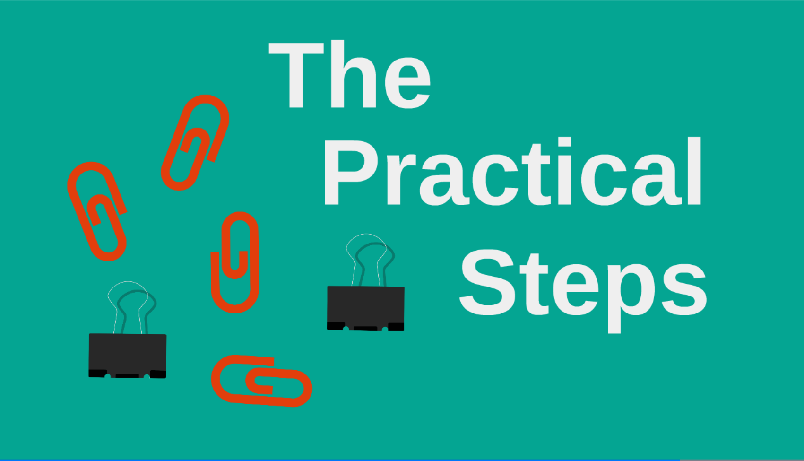
Notes:
Slide Time: 00:10 / 03:40

Slide 11

Best Practices for your MYOB setup
Notes:
Slide Time: 00:10 / 03:40

Slide 12

Getting the most from MYOB
  Clean up the Balance Sheet
  Reconcile Everything
  Go online
  Automate to save time
Notes:
Time: 01:00 / 10:00
Priority Support
One-on-one Mentoring
Weekly Communications
Website Resources
Free Events

Slide 13

Notes:
Slide Time: 00:10 / 03:40

Slide 14



Working with Calxa
  Link to MYOB
  Import Budgets
  Automate your reports
Notes:
Slide Time: 01:30 / 09:00
Client Reporting
Partner Program
On-sell to clients
Commissions of between 20-30%
Dedicated Account manager
Referrals & Website Listing
Online Partner Portal
Track your own business

Slide 15






Management Reporting
Financial Statements | Default KPIs | Custom KPIs
Consolidations | Benchmarking | Charts & Graphs
Notes:
Slide Time 00:50 / 2:50
Financial Statements
KPI’s - Standard Business Ratios
KPI Editor – Create your own
Multi-file Consolidations
Benchmarking
Charts & Graphs

Slide 16
The Specifics
  www.calxa.com
    Features
    Calxa for NFPs in NZ
    Get the Checklist
Notes:
Slide Time: 00:20 / 00:20

Slide 17
Next Steps
For you
Notes:
Slide Time 00:10 / 05:40

Slide 18
Make a plan
  Review your MYOB file
  Organise a Calxa donation or discount
  Get started
  Practice
  Test
  Review
Notes:
Slide Time: 00:20 / 00:20

Slide 19
Next Steps
For us
Notes:
Slide Time 00:10 / 05:40

Slide 20
We have a plan
  January 2016: Easier editing of notes
  March 2016: Easier non-financial KPIs
  April 2016: Scheduled updates from MYOB
  April 2016: Scheduled delivery of reports
  Note: All dates are our best available estimates
Notes:
Slide Time: 00:20 / 00:20

Slide 21

Take Action!
Do you qualify for a donation? Talk to Tech Soup
Notes:
Slide Time 01:00 / 37:00
Promote upcoming weekly Get Started Webinar for Accountants
Free 30 day Trial
Money Back Guarantee
Cancel Subscription at any time

Slide 22
  www.calxa.com/freetrial
  E: tellmemore@calxa.com
  P: 0800 086 614
Notes:
Slide Time 01:00 / 38:00
Questions?

